Slide 1
BCSE305L Embedded Systems

Slide 2


Slide 3
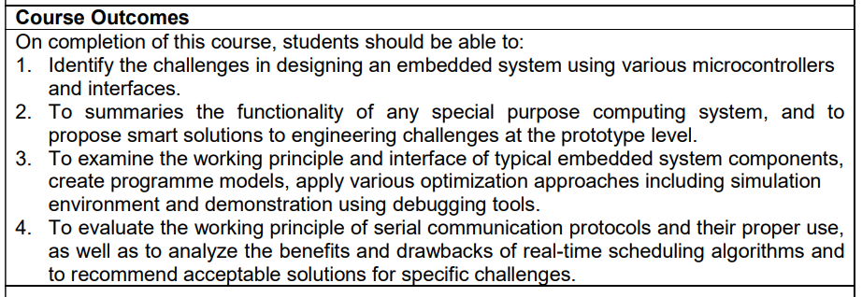

Slide 4
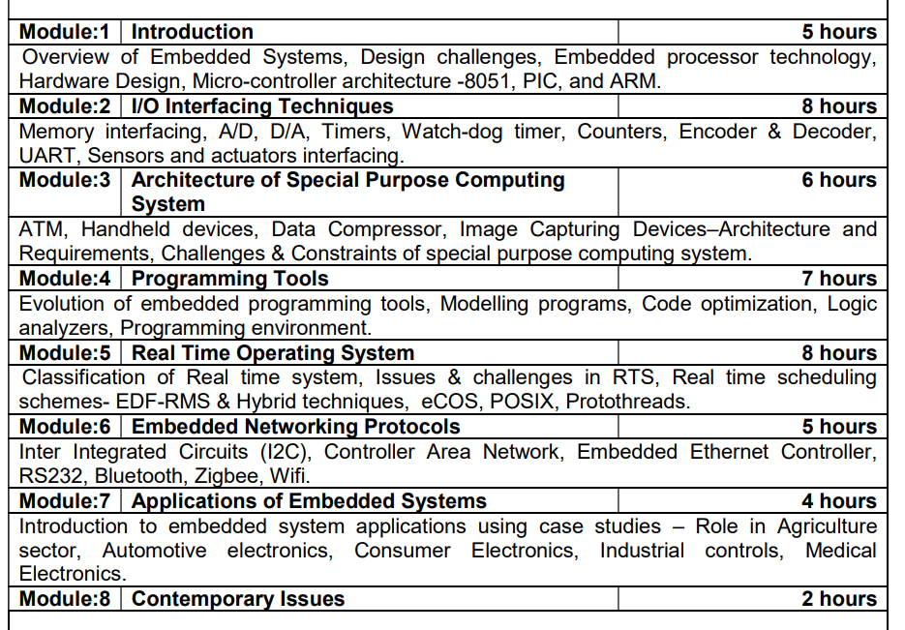

Slide 5


